Slide 1

Food waste reduction of joghurt products through sales forecaste
Kathrin Leitner, Burkay Kazan
HSLU – Customer Data Analytics
October 28th, 2022

Slide 2

What do you think is the share of environmental pollution caused by food waste in Switzerland?

Slide 3
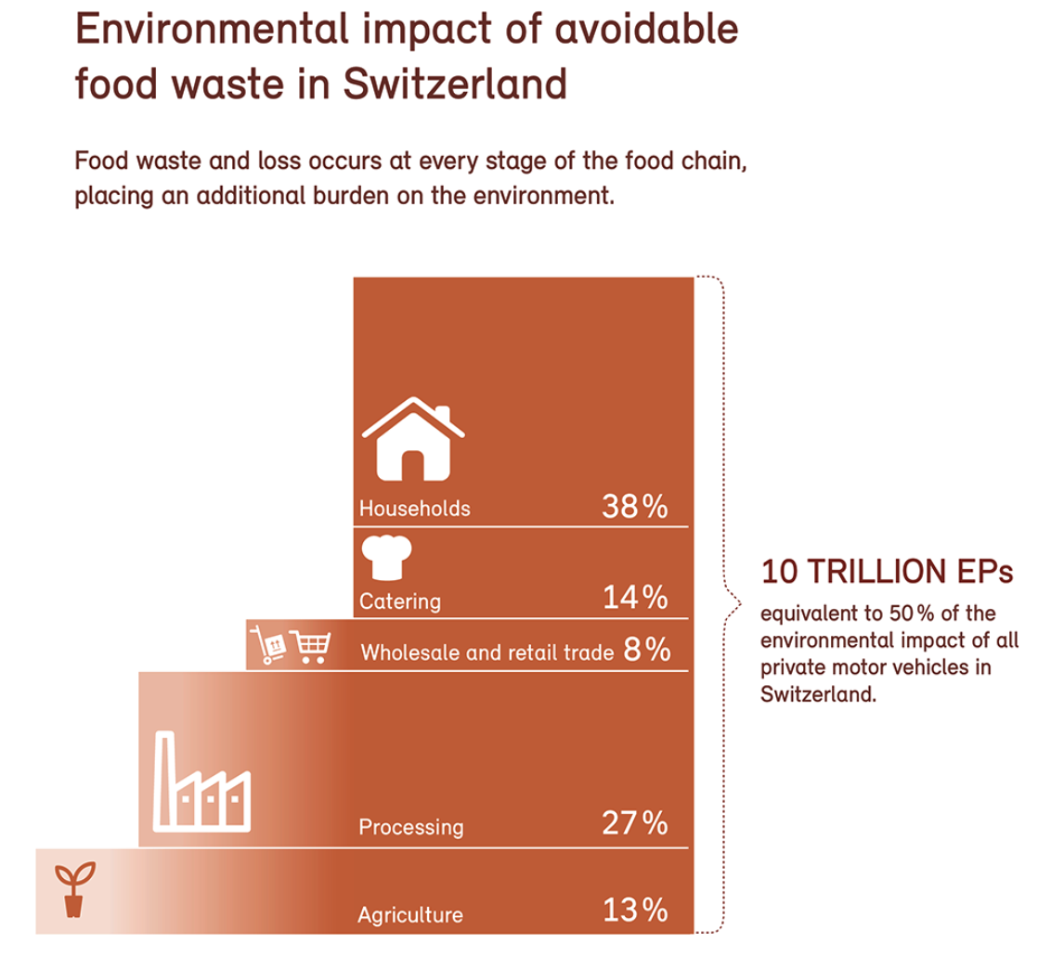
What is our problem?
In Switzerland, food causes around 30% of all environmental pollution. 25% of this environmental impact is due to avoidable food waste. This corresponds to about half the environmental impact of motorised private transport in Switzerland.
Source: https://www.bafu.admin.ch/bafu/en/home/topics/waste/guide-to-waste-a-z/biodegradable-waste/types-of-waste/lebensmittelabfaelle.html)

Slide 4
Our Aim: Reduce Food Waste through Sales Forecasts
Prediction of Forecast sales
Use Forecast to optimize production planning
Less Food is wasted

Slide 5
Benefit: Value proposition for business
reap economic and cash flow benefits
improving scope of emission footprint
increase reputational benefit by engagement

Slide 6
Main Questions
- What is the sales forecast by yoghurts article with a time horizon of 2 months?
- Which factors may influence the number from a statistical viewpoint?

Slide 7
Approach
Data Preperation
Data Exploration
Adding Features
Modelling
Evaluation
Deployment
Presentation

Slide 8
Features
Existing
Promo
Taste
Public
Holidays
Added
Sales
Date
Product
Joghurt
Categories
Gramm

Slide 9
Models: Regression & Time Series Analysis
Model | Version
1 | Linear Regression with all features (stats & sklearn)
2 | Linear Regression with selected features (stats & sklearn)
3 | Rigid regression in order to deal with mulitcolinearity (sklearn)
4 | Generalized additive model (Basline)
5 | Time Series Analysis with Holt-Winters

Slide 10
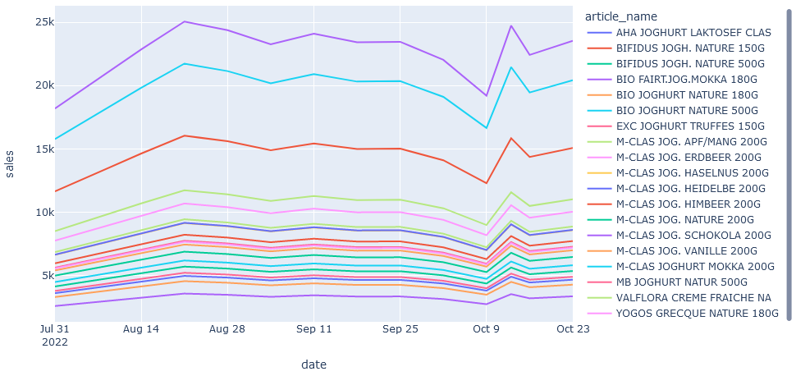
Outcome
Best Model: Holt Winters 8% MAPE
Explainable factors: Mainly promotional activities in varying degrees

Slide 11
Limitations, Implications & Outlook
Limitations: The project is a “pilot study” with limited time resources → consequences are methodological limitations
Practical Implications: project can inspire the business unit to start thinking and engaging profoundly about possible food waste reduction strategies by using ML
Outlook: including actors and data along the whole yoghurt value chain
USP: Explainability in Models used for transparent stakeholder communication → good potential to move forward to more complex models

Slide 12

Demo ☺

